Slide 1

Project Aristo: Towards Machines that Capture and Reason with Science Knowledge
Peter Clark
November 2019

Slide 2



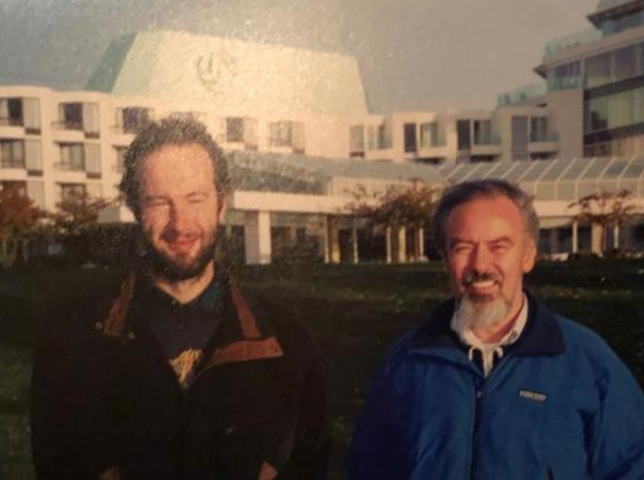
The History of KCap
KCap 2001-19
…
Notes:
What structures do we need – knowledge graphs, problem-solving methods, …?
and how do we populate them?
Somewhat of a crisis for knowledge capture: forget the structures,

Slide 3
The History of KCap
KCap 2001-19
…
Banff Knowledge Acquisition Workshops: 1986-1999
How do we get knowledge into the machine in a usable form?
Notes:
What structures do we need – knowledge graphs, problem-solving methods, …?
and how do we populate them?
Somewhat of a crisis for knowledge capture: forget the structures,

Slide 4



A Question for the field of Knowledge Capture
Structured
Knowledge
problem
relevant
information
Language
(and other
media)

Slide 5
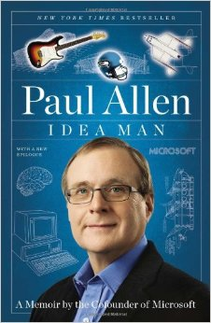
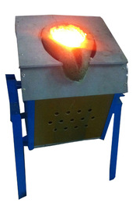
Science Questions: A Grand Challenge…
Over the last decade, I began to think about a "Digital Aristotle", an easy-to-use, all-encompassing knowledge storehouse....to advance the field of AI.
How are the particles in a block of iron affected when the block is melted?
(A) The particles gain mass.
(B) The particles contain less energy.
(C) The particles move more rapidly.
(D) The particles increase in volume.

Slide 6
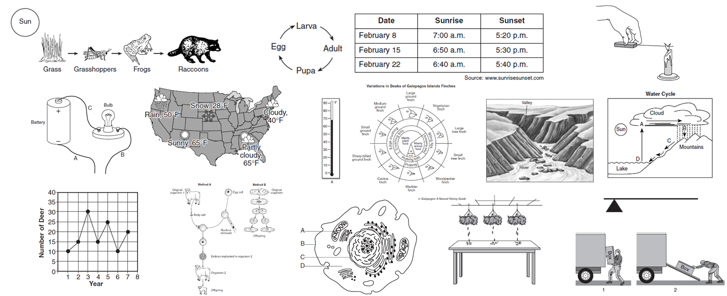
Question Categories Not Covered
Diagrams
Direct Answer Questions
Notes:
38 of 482 Regents 8th Grade DA questions are NDDA

Slide 7
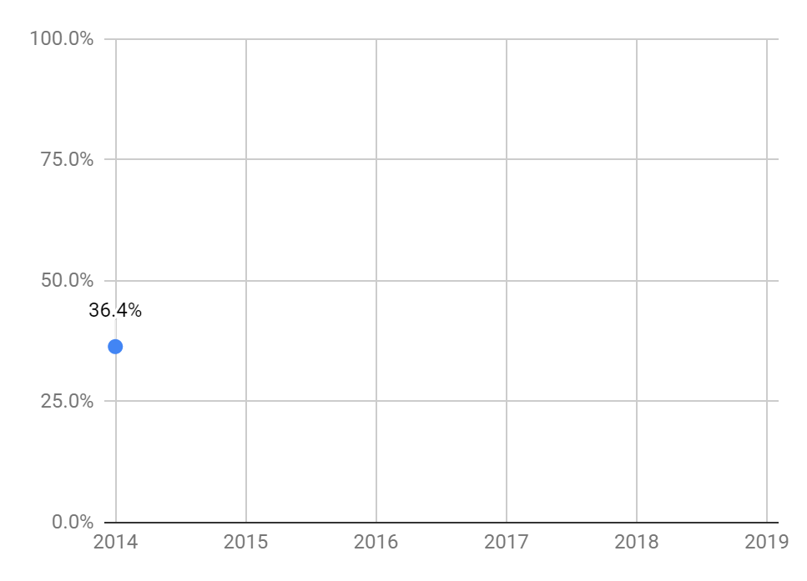
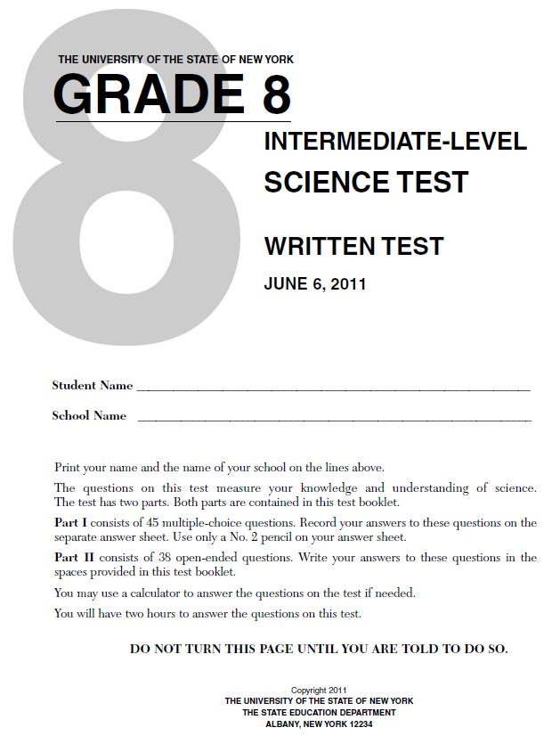
Progression on NY Regents 8th Grade (NDMC)
(random)
(hidden test set, questions as written, NDMC, 5 years/119 qns)

Slide 8
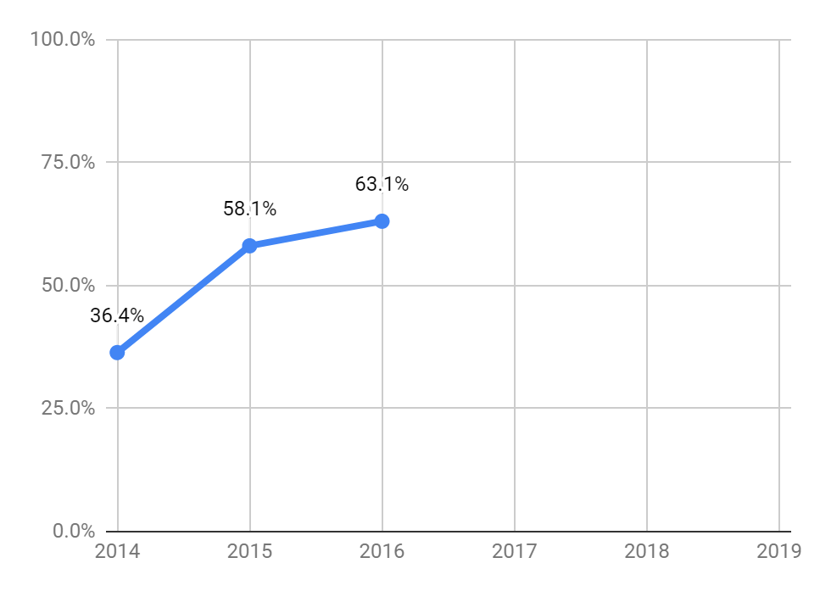
Progression on NY Regents 8th Grade (NDMC)
tables
+ rules
baseline
retrieval
methods
(random)
(hidden test set, questions as written, NDMC, 5 years/119 qns)

Slide 9
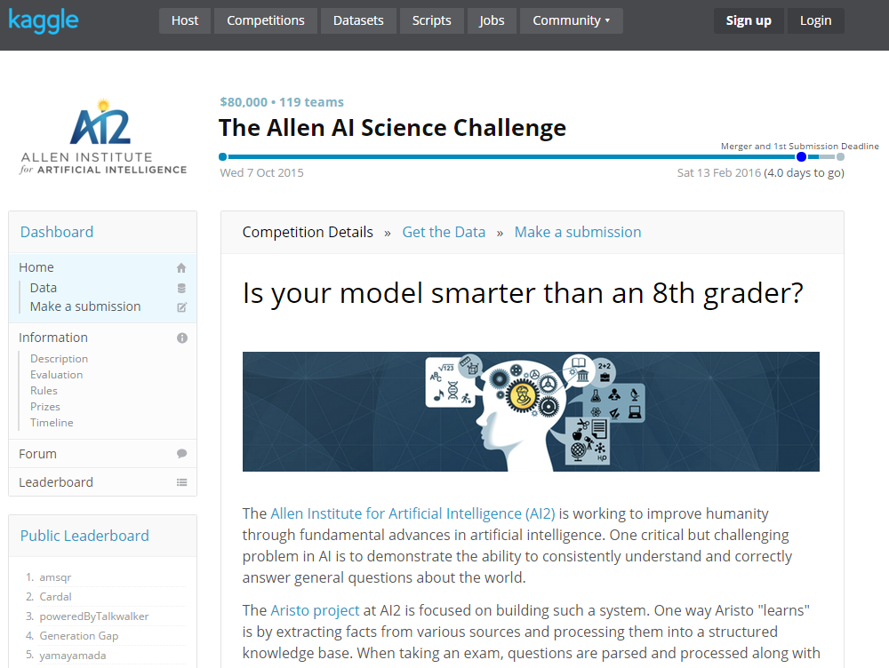

Slide 10

Progression on NY Regents 8th Grade (NDMC)
tables
+ rules
baseline
retrieval
methods
(random)
(hidden test set, questions as written, NDMC, 5 years/119 qns)

Slide 11
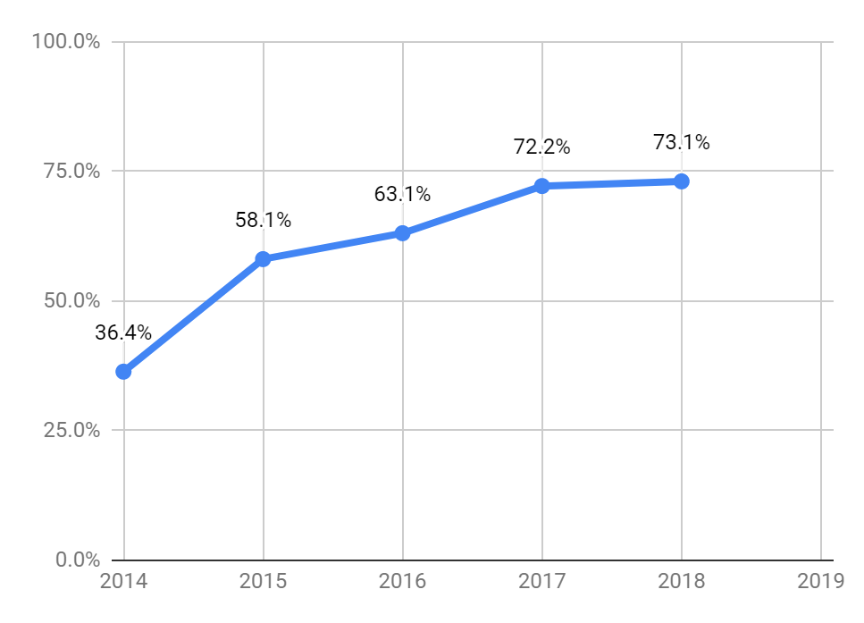
Progression on NY Regents 8th Grade (NDMC)
statistics +
retrieval +
reasoning
(AAAI’16)
tables
baseline
retrieval
methods
(random)
(hidden test set, questions as written, NDMC, 5 years/119 qns)

Slide 12
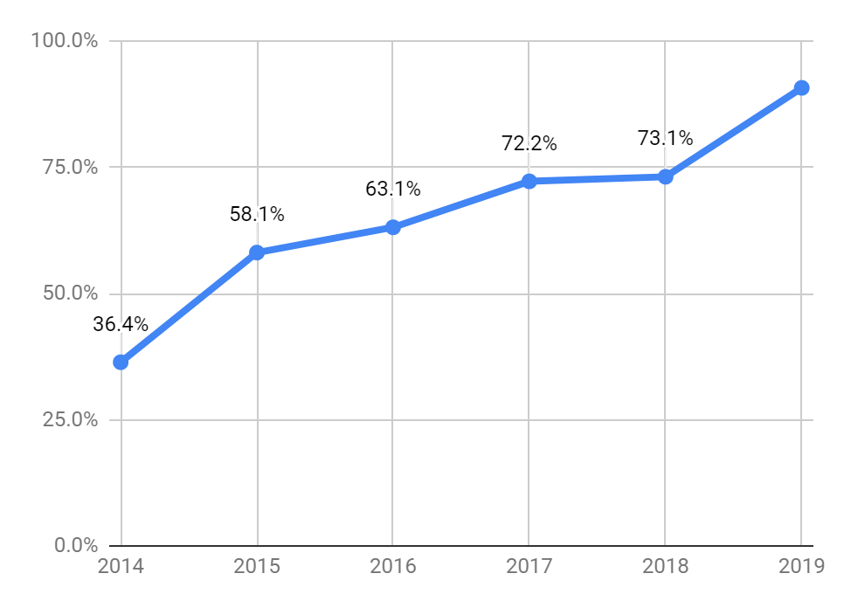
Progression on NY Regents 8th Grade (NDMC)
90.7%
language models
+ specialist solvers
statistics +
retrieval +
reasoning
(AAAI’16)
tables
baseline
retrieval
methods
(random)
Separate test on 3 latest exams (2017-2019): 93.3%
(hidden test set, questions as written, NDMC, 5 years/119 qns)
Notes:
EMNLP: Noam Slonim presented a similar chart for Project Debater
What is our intellectual contribution?
Answering REAL questions, AS WRITTEN, spanning a WIDE VARIETY OF PROBLEMS
A FAMILY OF METHODS for bringing KNOWLEDGE to bear on these PROBLEMS

Slide 13
Outline
Introduction
How does Aristo work?
What is going on behind the high scores on the exams?
Where does Aristo fail?
What are steps forward?

Slide 14

Aristo: an over-simplified overview
An ensemble architecture
ARISTO
Question
Retrieval
& Statistics
Structured Representation
Inference
Solvers
Answer
Web, Science
Combiner (Ensemble)
Text
Language
Models

Slide 15
Aristo: an over-simplified overview
An ensemble architecture
ARISTO
Question
Retrieval
& Statistics
Structured Representation
Inference
Solvers
Answer
Web, Science
Combiner (Ensemble)
Text
Language
Models

Slide 16
Aristo: an over-simplified overview
An ensemble architecture
ARISTO
Question
Retrieval
& Statistics
Structured Representation
Inference
Solvers
Answer
Web, Science
Combiner (Ensemble)
Text
Language
Models

Slide 17
1. Table Knowledge
In New York State, the longest period of daylight occurs during which month? (A) June
(B) March (C) December (D) September

Slide 18
1. Table Knowledge
In New York State, the longest period of daylight occurs during which month? (A) June
(B) March (C) December (D) September
Daylengths in different months and locations?
Solstices?
Where is New York State?
Which hemisphere is it in?

Slide 19
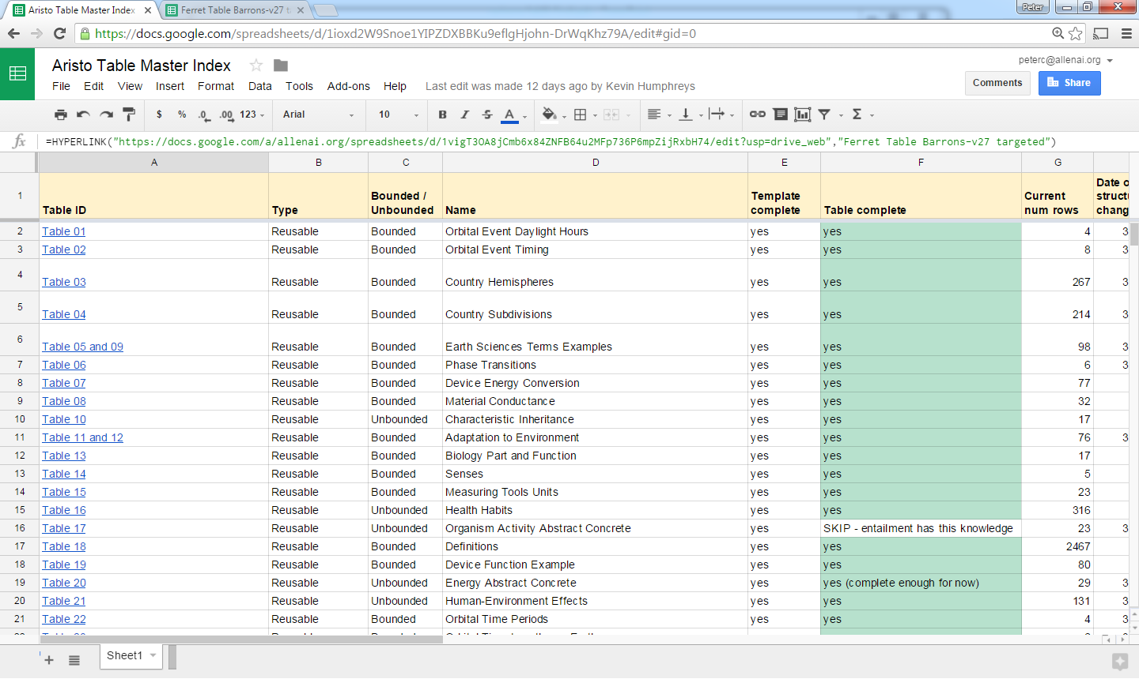
1. Table Knowledge: Aristo’s Tablestore
~120 tables, ~10-500 rows each
Defined with respect to questions, study guides, syllabus

Slide 20
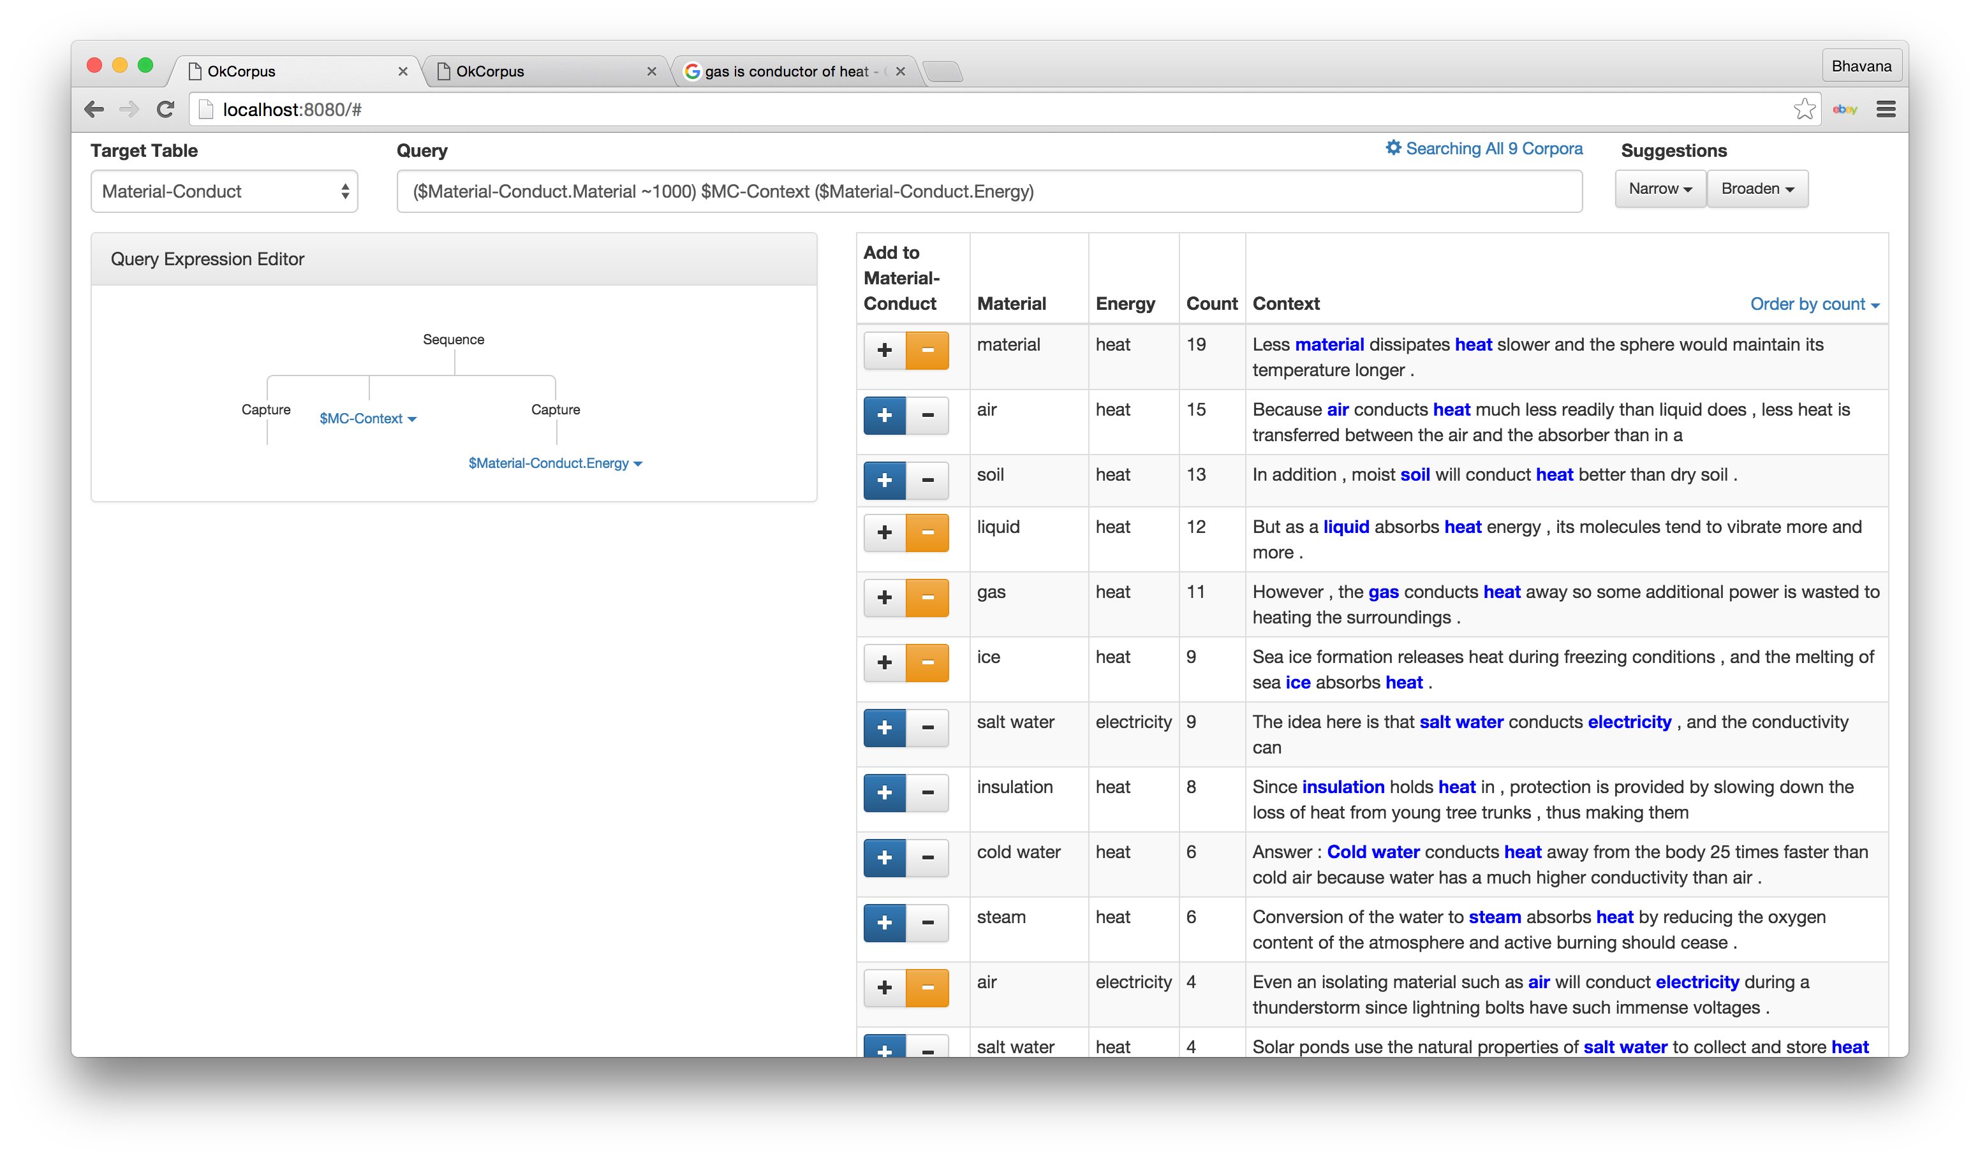
IKE – Interactive Knowledge Extraction
(AKBC’16)

Slide 21
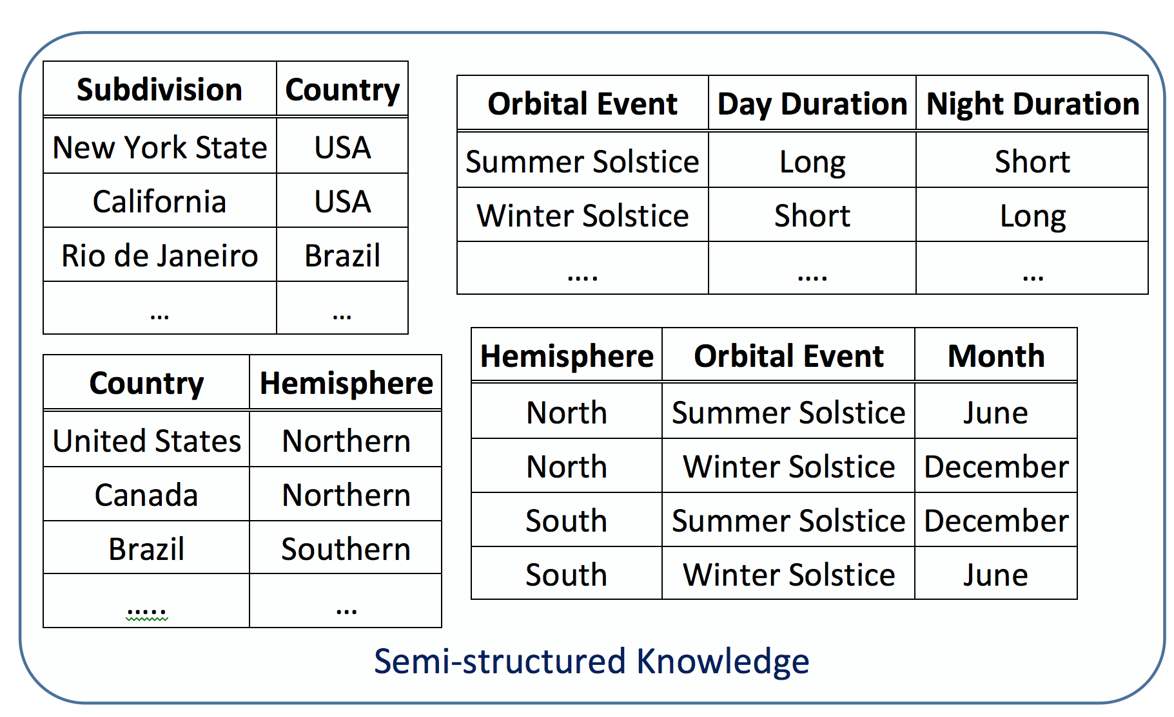
1. Table Inference
In New York State, the longest period of daylight occurs during which month? (A) June
(B) March (C) December (D) September

Slide 22
2. Table Inference
In New York State, the longest period of daylight occurs during which month? (A) June
(B) March (C) December (D) September

Slide 23
1. Table Inference
In New York State, the longest period of daylight occurs during which month? (A) June
(B) March (C) December (D) September

Slide 24
1. Table Inference
In New York State, the longest period of daylight occurs during which month? (A) June
(B) March (C) December (D) September

Slide 25
1. Table Inference
In New York State, the longest period of daylight occurs during which month? (A) June
(B) March (C) December (D) September
IJCAI’16

Slide 26
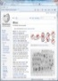
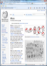

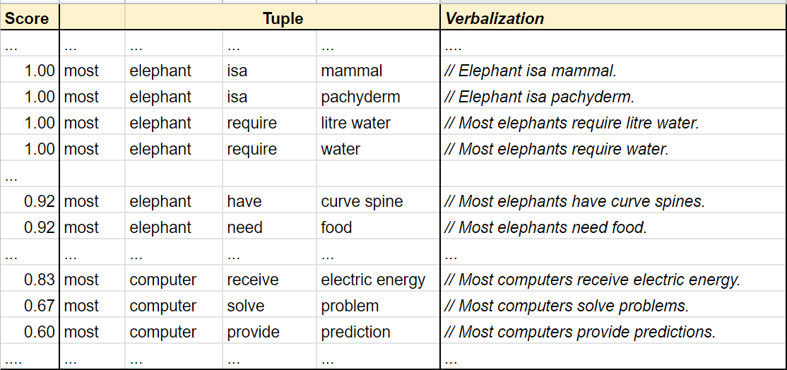
2. Tuple Knowledge
Search
Tuple
Extraction
Headword
Extraction
Scoring
+ Filtering
Regen-eration
Canonical-ization
(ACL’17)

Slide 27
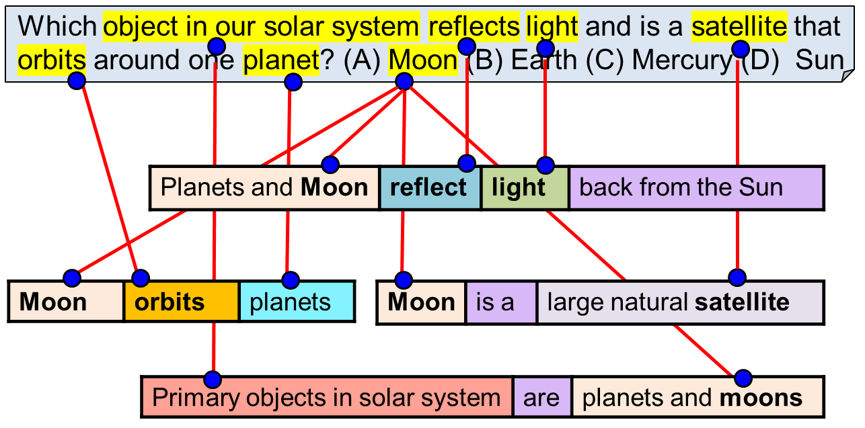


2. Tuple Inference
Stormy weather negatively affects a coastline by (A) causing erosion (B) causing earthquakes (C) increasing food production (D) increasing the growth of grasses
Tuple KB
Lexical
Tuples
Semantic Transformation
Semantic
Tuples
Tuple Chaining
Expanded
Tuples
Support Graph Search
Text Corpus
waves | often result in | erosion
waves | cause | erosion
storms | cause | erosion
storms | can generate | waves
storms | cause | waves

Slide 28
Aristo: an over-simplified overview
An ensemble architecture
ARISTO
Question
Retrieval
& Statistics
Structured Representation
Inference
Solvers
Answer
Web, Science
Combiner (Ensemble)
Text
Language
Models

Slide 29
Aristo: an over-simplified overview
An ensemble architecture
ARISTO
Question
Retrieval
& Statistics
Structured Representation
Inference
Solvers
Answer
Web, Science
Combiner (Ensemble)
Text
Language
Models

Slide 30


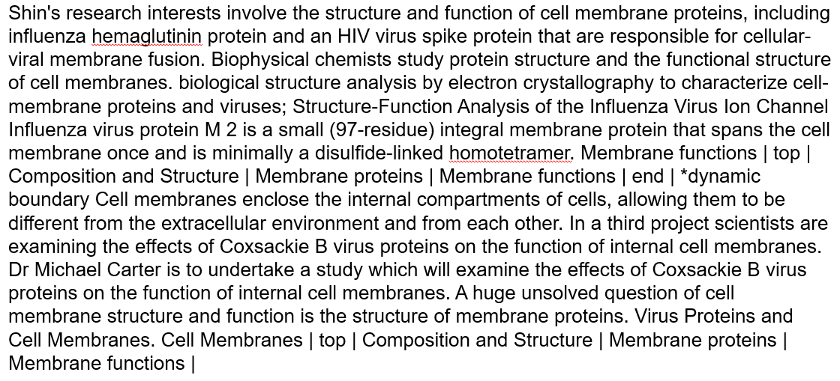

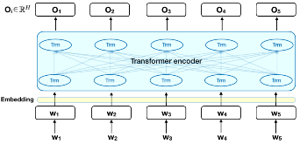
BERT and RoBERTa
Aristo Text Corpus
(0.3TB)
Multi-step Curriculum Training
What part of a plant needs sunlight to do its job? (A) leaf…
Background
Science
Regents
[CLS] context [SEP] question
[SEP] answer-option
Notes:
The [CLS] output token for each
answer option is projected to a single logit and fed through
a softmax layer, trained using cross-entropy loss against the
correct answer.
RACE has ~100k questions.

Slide 31
Where is the Knowledge Capture?
What part of a plant needs sunlight to do its job? (A) leaf
Notes:
The [CLS] output token for each
answer option is projected to a single logit and fed through
a softmax layer, trained using cross-entropy loss against the
correct answer.

Slide 32
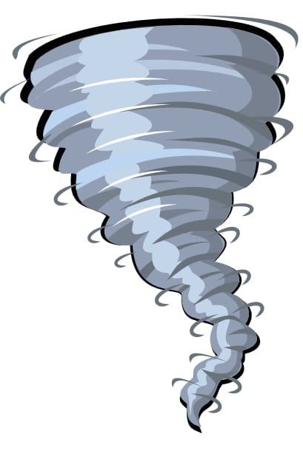
Where is the Knowledge Capture?
What part of a plant needs sunlight to do its job? (A) leaf
Wikipedia + BookCorpus
(2.5B words + 11k books)
Notes:
The [CLS] output token for each
answer option is projected to a single logit and fed through
a softmax layer, trained using cross-entropy loss against the
correct answer.

Slide 33

Where is the Knowledge Capture?
What part of a plant needs sunlight to do its job? (A) leaf
Wikipedia + BookCorpus
(2.5B words + 11k books)
Curriculum Training
Notes:
The [CLS] output token for each
answer option is projected to a single logit and fed through
a softmax layer, trained using cross-entropy loss against the
correct answer.

Slide 34

Where is the Knowledge Capture?
Aristo Corpus
(2B words)
What part of a plant needs sunlight to do its job? (A) leaf…
Wikipedia + BookCorpus
(2.5B words + 11k books)
Curriculum Training
Notes:
The [CLS] output token for each
answer option is projected to a single logit and fed through
a softmax layer, trained using cross-entropy loss against the
correct answer.

Slide 35
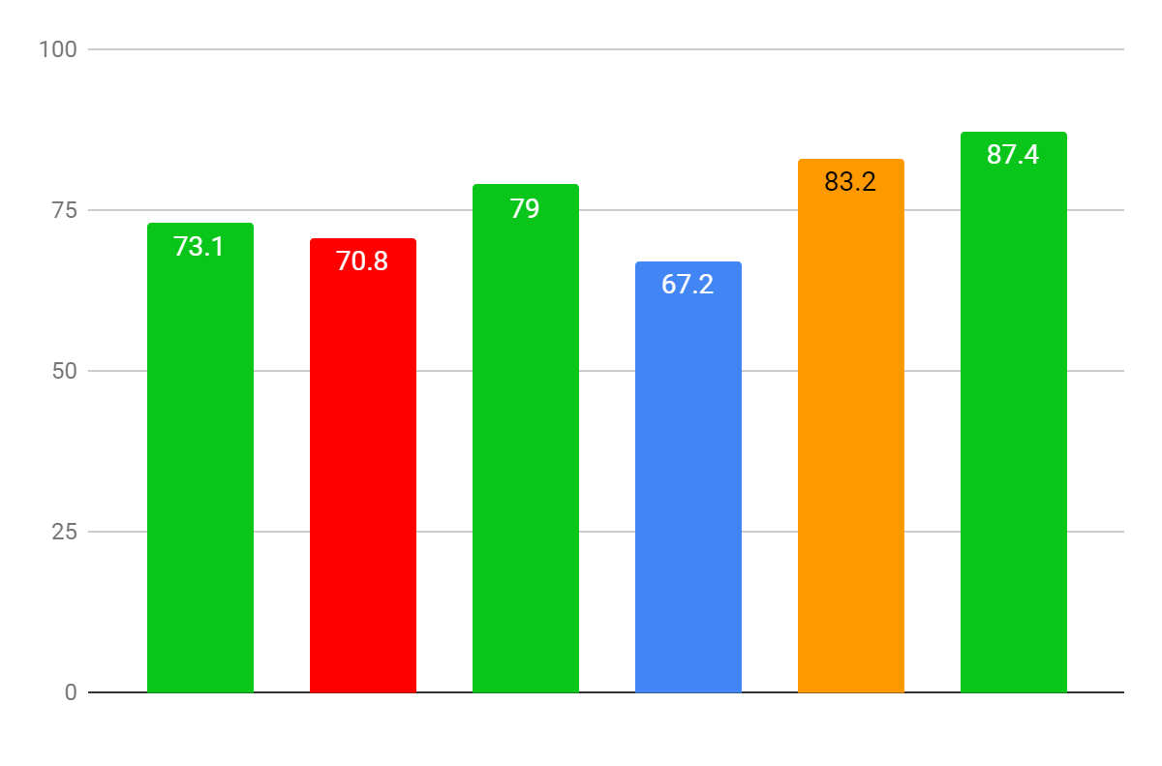
Exploiting Language Models
Earlier
solvers
Multee
Earlier
solvers
+ Multee
BERT
AristoBERT
ARISTO!

Slide 36
Exploiting Language Models
Earlier
solvers
Multee
Earlier
solvers
+ Multee
BERT
AristoBERT
ARISTO!

Slide 37
Exploiting Language Models
Earlier
solvers
Multee
Earlier
solvers
+ Multee
BERT
AristoBERT
ARISTO!

Slide 38
Exploiting Language Models
Earlier
solvers
Multee
Earlier
solvers
+ Multee
BERT
AristoBERT
ARISTO!

Slide 39
Exploiting Language Models
Earlier
solvers
Multee
Earlier
solvers
+ Multee
BERT
AristoBERT
ARISTO!

Slide 40
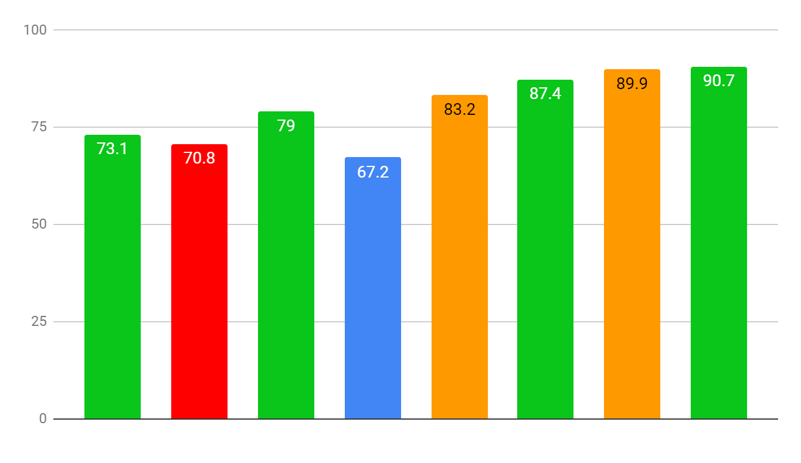
Exploiting Language Models
Earlier
solvers
Multee
Earlier
solvers
+ Multee
BERT
AristoBERT
Earlier
solvers
+ Multee
+AristoBERT
Aristo-
Roberto
ARISTO!

Slide 41
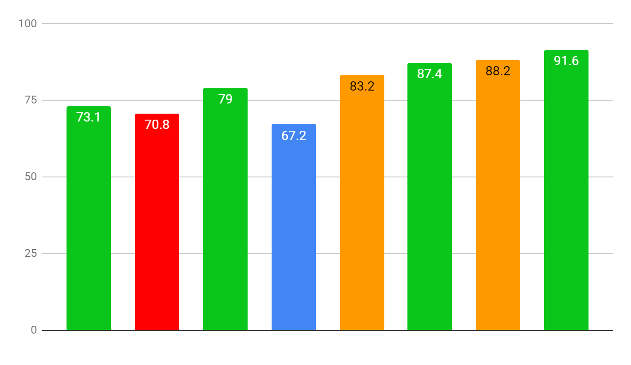
Exploiting Language Models
Earlier
solvers
Multee
Earlier
solvers
+ Multee
BERT
AristoBERT
Earlier
solvers
+ Multee
+AristoBERT
Aristo-
Roberta
ARISTO!

Slide 42
Exploiting Language Models
Earlier
solvers
Multee
Earlier
solvers
+ Multee
BERT
AristoBERT
Earlier
solvers
+ Multee
+AristoBERT
Aristo-
Roberta
ARISTO

Slide 43
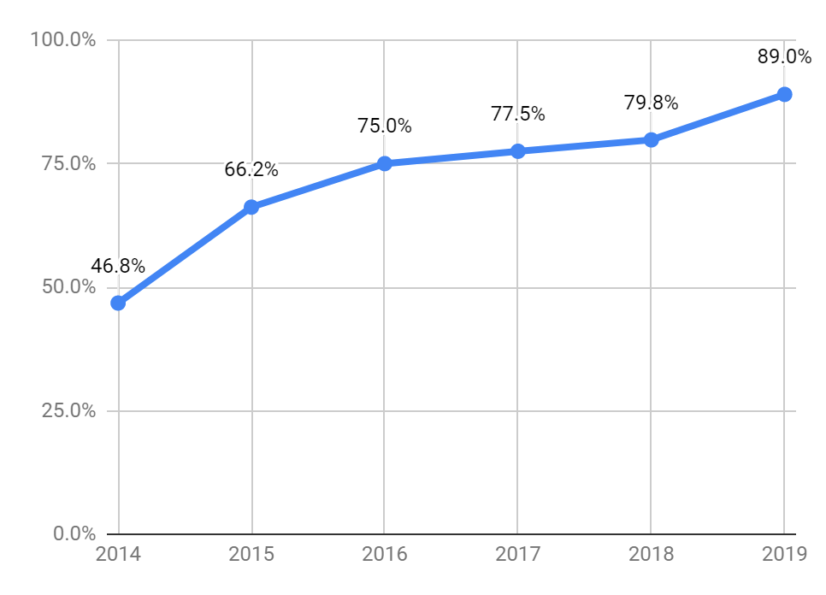
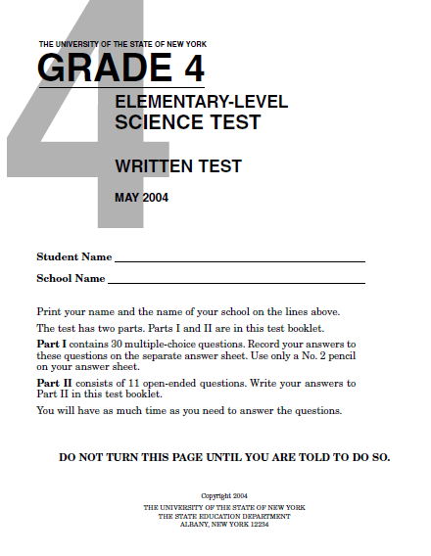
Similar Progress on 4th Grade NDMC
89.9%
(random)
Similarly on 12th grade NDMC:
Random: 25.0%
2014: 40.6%
2019: 83.5%
Notes:
(22 (hidden) test exams, 632 qns)

Slide 44
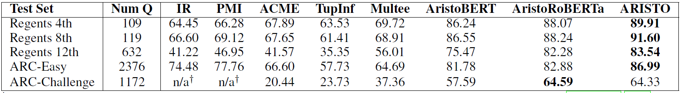

Individual Solver Performances
Most of the heavy lifting….
Notes:
What’s going on inside? Just glorified pattern matching or…?
Did we waste our time with knowledge capture?
Do we need structured reasoning?
Do we need structured knowledge?

Slide 45
Outline
Introduction
How does Aristo work?
What is going on behind the high scores on the exams?
Where does Aristo fail?
What are steps forward?

Slide 46
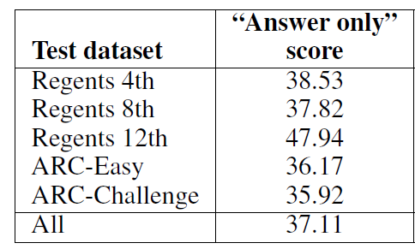
1. Checking for annotation artifacts
The condition of the air outdoors at a certain time of day is known as
(A) friction
(B) light
(C) force
(D) weather

Slide 47

2. Is it fooled by “obviously wrong” answers?
The condition of the air outdoors at a certain time of day is known as
(A) friction
(B) light
(C) force
(D) weather [selected, correct]
✓
The condition of the air outdoors at a certain time of day is known as
(A) friction (E) joule
(B) light (F) gradient
(C) force (G) trench
(D) weather (H) add heat

Slide 48
2. Is it fooled by “obviously wrong” answers?
The condition of the air outdoors at a certain time of day is known as
(A) friction
(B) light
(C) force
(D) weather [selected, correct]
✓
The condition of the air outdoors at a certain time of day is known as
(A) friction (E) joule
(B) light (F) gradient [selected]
(C) force (G) trench
(D) weather [correct] (H) add heat
✘
Retrain
The condition of the air outdoors at a certain time of day is known as
(A) friction (E) joule
(B) light (F) gradient
(C) force (G) trench
(D) weather [correct,selected] (H) add heat
✓

Slide 49
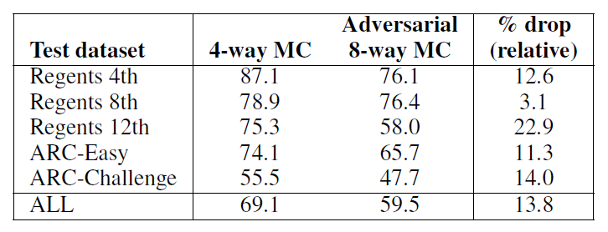
2. Is it fooled by “obviously wrong” answers?
The condition of the air outdoors at a certain time of day is known as
(A) friction
(B) light
(C) force
(D) weather [selected, correct]
✓
The condition of the air outdoors at a certain time of day is known as
(A) friction (E) joule
(B) light (F) gradient [selected]
(C) force (G) trench
(D) weather [correct] (H) add heat
✘
Drop of (only) ≈ 10 points
Retrain
The condition of the air outdoors at a certain time of day is known as
(A) friction (E) joule
(B) light (F) gradient [selected]
(C) force (G) trench
(D) weather [correct,selected] (H) add heat
✓

Slide 50
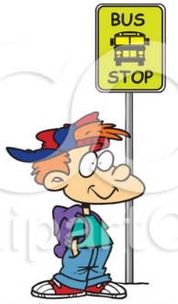
3. More than Pattern Matching?
City administrators can encourage energy conservation by
(1) lowering parking fees
(2) building larger parking lots
(3) decreasing the cost of gasoline
(4) lowering the cost of bus and subway fares
✓

Slide 51
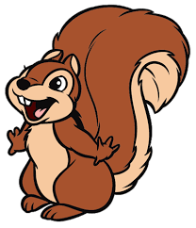
3. More than Pattern Matching?
City administrators can encourage energy conservation by
(1) lowering parking fees
(2) building larger parking lots
(3) decreasing the cost of gasoline
(4) lowering the cost of bus and subway fares
increasing
✓
raising
Which of the following organs does a squirrel not have
(A) a brain
(B) gills
(C) a heart
(D) lungs
✓

Slide 52
3. More than Pattern Matching?
City administrators can encourage energy conservation by
(1) lowering parking fees
(2) building larger parking lots
(3) decreasing the cost of gasoline
(4) lowering the cost of bus and subway fares
increasing
✓
raising
Which of the following organs does a squirrel not have
(A) a brain
(B) gills
(C) a heart
(D) lungs
✓

Slide 53

3. More than Pattern Matching?
2019 Report Card for
Aristo
Subject
Grade
Teacher Comments
Negation
A
Nice work!
94%
Conjunction
Polarity
World tracking
Factivity
Counting
Alan is small. Alan is tall. Bob is big. Bob is tall.
Charlie is big. Charlie is tall. David is small. David is short.
Which of the following is not tall? (A) Alan (B) Bob (C) Charlie (D) David [correct]

Slide 54
3. More than Pattern Matching?
2019 Report Card for
Aristo
Subject
Grade
Teacher Comments
Negation
A
Nice work!
94%
Conjunction
Polarity
World tracking
Factivity
Counting

Slide 55
Synthetic Conjunction Test
Context:
Alan is red.
Alan is big.
Bob is blue.
Bob is small.
Charlie is blue.
Charlie is big.
David is red.
David is small.
Question:
Which of the following is big and blue? (A) Alan (B) Bob (C) Charlie [correct] (D) David
1 conjunct: 98%
2 conjuncts: 95%
3 conjuncts: 94.5%
4 conjuncts: 80%
88.5%
76.5%
76%
75%
+ 1 negation
Alan is red. Alan is big. Alan is light. Alan is old. Alan is tall. Bob is red. Bob is small. Bob is heavy. Bob is old. Bob is tall. Charlie is blue. Charlie is big. Charlie is light. Charlie is old. Charlie is tall. David is red. David is small. David is heavy. David is young. David is tall.
Which of the following is old and red and light and big and not short? (A) Alan (B) Bob (C) Charlie (D) David

Slide 56
3. More than Pattern Matching?
2019 Report Card for
Aristo
Subject
Grade
Teacher Comments
Negation
A
Nice work!
94%
Conjunction
B+
80% -98%
Polarity
World tracking
Factivity
Counting

Slide 57
3. More than Pattern Matching?
2019 Report Card for
Aristo
Subject
Grade
Teacher Comments
Negation
A
Nice work!
94%
Conjunction
B+
80% -98%
D+
Could ace this with more study!
Polarity
67.1%
World tracking
Factivity
Counting
Context:
For a given medium, sound has a slower speed at lower temperatures.
up
Question:
If Jim turns the thermostat down in his room while listening to music, what will happen to the speed of the sound waves in the room?
(A) they will speed up (B) they will slow down [correct]
[correct]

Slide 58
3. More than Pattern Matching?
2019 Report Card for
Aristo
Subject
Grade
Teacher Comments
Negation
A
Nice work!
94%
Conjunction
B+
80% -98%
D+
Could ace this with more study!
Polarity
67.1%
World tracking
C
72.5%
Factivity
Counting
Context:
If someone travels for longer, they will travel further.
Question:
John and Rita are going for a run. Rita gets tired and takes a break on the park bench. After twenty minutes in the park, who has run farther?
(A) John [correct] (B) Rita

Slide 59
3. More than Pattern Matching?
2019 Report Card for
Aristo
Subject
Grade
Teacher Comments
Negation
A
Nice work!
94%
Conjunction
B+
80% -98%
D+
Could ace this with more study!
Polarity
67.1%
World tracking
C
72.5%
Factivity
D
66.5%
Counting
If someone regretted that a particular thing happened then
(A) that thing might or might not have happened .
(B) that thing didn't happen .
(C) that thing happened [correct]

Slide 60
3. More than Pattern Matching?
2019 Report Card for
Aristo
Subject
Grade
Teacher Comments
Negation
A
Nice work!
94%
Conjunction
B+
80% -98%
D+
Could ace this with more study!
Polarity
67.1%
World tracking
C
72.5%
Factivity
D
66.5%
Counting
F
6%
Daniel picked up the football. Daniel dropped the football. Daniel got the milk.
How many objects is Daniel holding? (A) zero (B) one (C) two (D) three

Slide 61
Outline
Introduction
How does Aristo work?
What is going on behind the high scores on the exams?
Where does Aristo fail?
What are steps forward?

Slide 62

4. Where is Aristo Failing?
What part of a plant needs sunlight to do its job? (A) leaf…

Slide 63
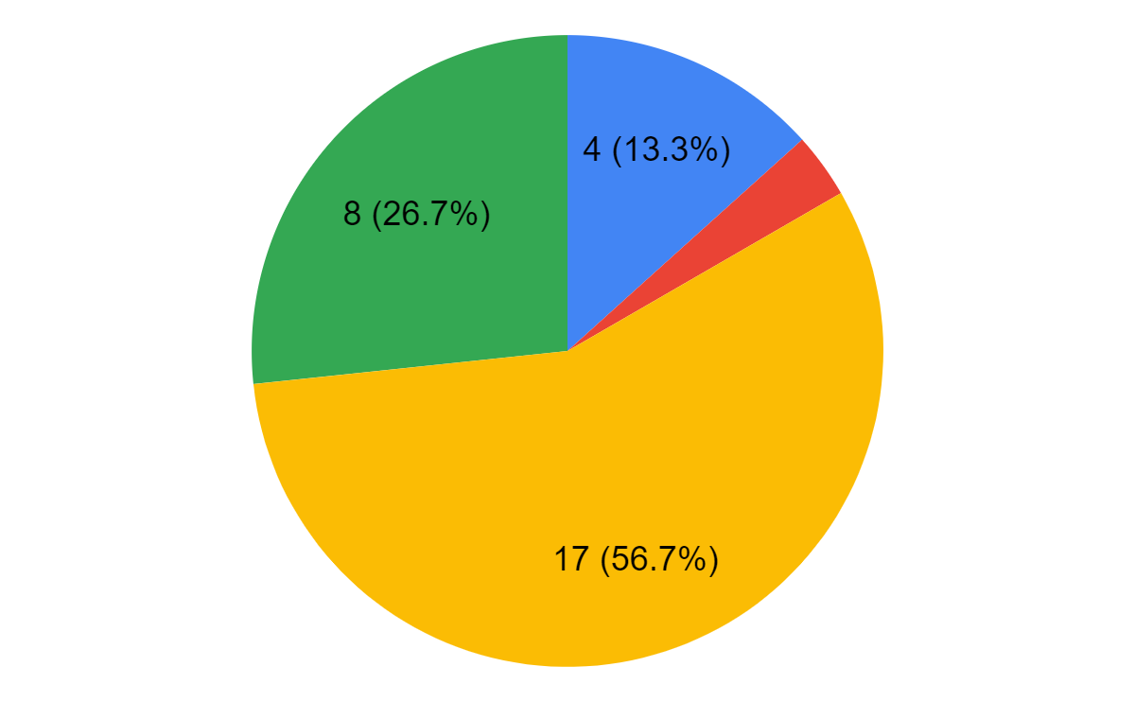
4. Where is Aristo failing?
Case study on 30 failures:
Good support for correct answer
Reading Comprehension
(IR won’t help)
Good support for incorrect answer
No good support

Slide 64

1. Good support for the correct answer (13%)
Which is the best unit to measure distances between Earth and other solar systems in the universe? (A) miles (B) kilometers (C) light years (D) astronomical units
In general, distances in the solar system are measured in astronomical units.
Distances between Earth and the stars are often measured in terms of light-years.

Slide 65
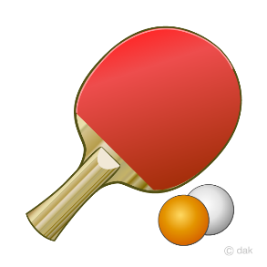
2. Good support for the incorrect answer (3%)
Which of these objects will most likely float in water? (A) glass marble (B) steel ball (C) hard rubber ball (D) table tennis ball
I remember it had like a rubber ball in it, which would maybe float up…
We played soccer with a giant rubber ball that floated like a balloon.
Rubber toys floated on the water.

Slide 66
3. No good support for the correct answer (57%)
Although they belong to the same family, an eagle and a pelican are different. What is one difference between them? (A) their preference for eating fish (B) their ability to fly (C) their method of reproduction (D) their method of catching food
Need question decomposition
How are the particles in a block of iron affected when the block is melted? (A) The particles gain mass. (B) The particles contain less energy. (C) The particles move more rapidly. (D) The particles increase in volume.
No good single supporting sentence
Notes:
Q1: Aristo does not understand the question
Q2: Not able to pivot through an intermediate concept

Slide 67
3. No good support for the correct answer (57%)
Which characteristic applies to animals in only one of these taxonomic groups: reptiles, mammals, birds, amphibians, or fishes? (A) have hair (B) lay eggs (C) have webbed feet (D) breathe with gills
Boolean reasoning
Which geologic structure will most likely take the longest time to form? (A) a fault (B) a sinkhole (C) a river meander (D) a mountain range
Cross-option comparative
Notes:
[could skip this slide]
Q3: Aristo doesn’t understand the question
Q4: Aristo architecture wrong to make sense of this

Slide 68
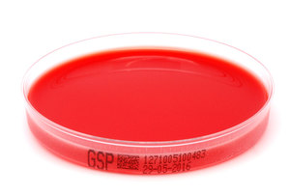

4. Reading Comprehension (27%)
Story (experimental method)
A student wants to determine the effect of garlic on the growth of a fungus species. Several samples of fungus cultures are grown in the same amount of agar and light. Each sample is given a different amount of garlic. What is the independent variable in this investigation? (A) amount of agar (B) amount of light (C) amount of garlic (D) amount of growth
Meta/sentiment
Which statement is an opinion? (A) Many plants are green. (B) Many plants are beautiful. (C) Plants require sunlight. (D) Plants can grow in different places.

Slide 69

Math Reasoning
About how long does it take for the Moon to complete one revolution around Earth? (A) 7 days (B) 30 days (C) 90 days (D) 365 days
Because it takes the moon about 27.3 days to complete one orbit around the Earth, the moon moves a little bit further around the Earth each day.
It takes 27.3 days for the moon to complete one revolution around the earth.
The moon completes one revolution of the Earth in about 29.5 days.
The Moon completes one revolution around the Earth in 27.32166 days.

Slide 70
Outline
Introduction
How does Aristo work?
What is going on behind the high scores on the exams?
Where does Aristo fail?
What are steps forward?
Notes:
Do we still need structured reasoning? Yes! This is the way forward to solving these problems. We’ve asympototed on how well LMs will do.

Slide 71
1. Question Decomposition
What virus structure is similar in function to a cell membrane?
(A) protein shell (B) internal protein...
structure-function of membrane proteins. membrane protein structure and function; Structure and function of membrane proteins; Shin's research interests involve the structure and function of cell membrane proteins, including influenza hemaglutinin protein and an HIV virus spike protein that are responsible for cellular-viral membrane fusion. biological structure analysis by electron crystallography to characterize cell-membrane proteins and viruses; Structure-Function Analysis of the Influenza Virus Ion Channel Influenza virus protein M 2 is a small (97-residue) integral membrane protein that spans the cell membrane once and is minimally a disulfide-linked homotetramer. Biophysical chemists study protein structure and the functional structure of cell membranes. A huge unsolved question of cell membrane structure and function is the structure of membrane proteins. Virus Proteins and Cell Membranes. Cell Membranes | top | Composition and Structure | Membrane proteins | Membrane functions |

Slide 72
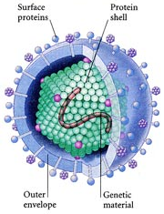
1. Question Decomposition
What virus structure is similar in function to a cell membrane?
(A) protein shell (B) internal protein...
What is the function of a cell membrane?
Surrounds and protects, gives structure, regulates material, ….
What part of the virus surrounds and protects it?
Protein shell, protein layer, …
GapQA (EMNLP’19)
New dataset coming

Slide 73
2. Multihop Reasoning
Which conducts electricity? (A) suit of armor (B) cotton candy

Slide 74
2. Multihop Reasoning
Which conducts electricity? (A) suit of armor (B) cotton candy
Retrieval 1:
The reciprocal of the electrical resistivity is the electrical conductivity.
Electrical conductivity is the capacity of metal to conduct an electric current.
Electrical Conductivity Water without minerals will not conduct electricity.

Slide 75
2. Multihop Reasoning
Which conducts electricity? (A) suit of armor (B) cotton candy
Retrieval 1:
The reciprocal of the electrical resistivity is the electrical conductivity.
Electrical conductivity is the capacity of metal to conduct an electric current.
Electrical Conductivity Water without minerals will not conduct electricity.
Retrieval 2:
It was not suited to be a center for extensive metal-working.
A suit of armour is a historical type of personal body armour made from metal.
Resisting arrest is a criminal charge, but civil suits can be filed.
Form Chains:
“suit of armor…made from metal” AND “…metal conduct electrical current”
=> “suit of armor conducts electricity”
☺
☹
“Resisting arrest…suits can be filed” AND “reciprocal of resistivity is conductivity”
=> “suit of armor conducts electricity”
Train system to recognize good chains

Slide 76
3. Modeling World States
Photosynthesis
Roots absorb water from the soil.
The water flows to the leaf.
Light and CO2 enter leaf.
Light, water, CO2 form sugar.
Notes:
What is procedural text? Text describes a sequence of events, describing what is happening to different entities in the world.
When we as humans read this paragraph, we not only understand it at surface level, but we can also build a world model in our mind.
If we have this world model, we can then infer things that aren’t explicit in the text.

Slide 77
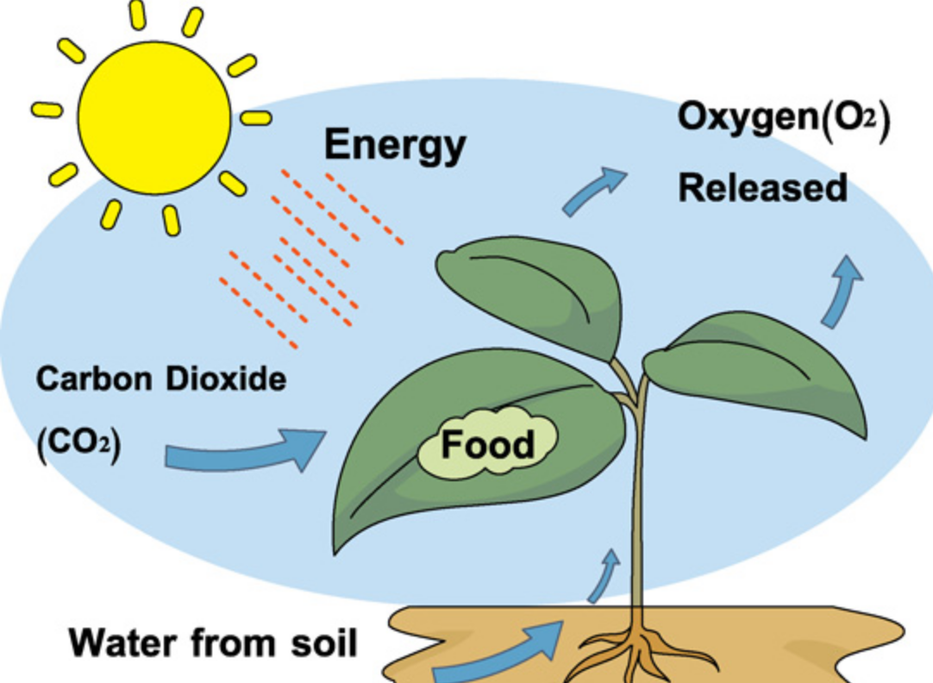
3. Modeling World States
Photosynthesis
Roots absorb water from the soil.
The water flows to the leaf.
Light and CO2 enter leaf.
Light, water, CO2 form sugar.
Where is the sugar created?
Light, water, CO2
[BiDAF]

Slide 78
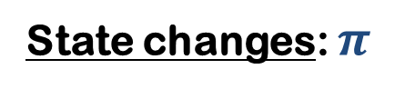
3. Modeling World States
Paragraph
State changes: $π$
water | light | CO2 | sugar
s1 | Roots absorb water from soil.
s2 | The water flows to the leaf.
s3 | Light and CO2 enter leaf.
s4 | Water, light, CO2 form sugar.
s1
s2
s3
s4

Slide 79
3. Modeling World States
Paragraph
State changes: $π$
water | light | CO2 | sugar
soil
roots
s1 | Roots absorb water from soil.
s2 | The water flows to the leaf.
s3 | Light and CO2 enter leaf.
s4 | Water, light, CO2 form sugar.
s1
s2
s3
s4

Slide 80
3. Modeling World States
Paragraph
State changes: $π$
water | light | CO2 | sugar
soil
roots
s1 | Roots absorb water from soil.
s2 | The water flows to the leaf.
s3 | Light and CO2 enter leaf.
s4 | Water, light, CO2 form sugar.
s1
s2
s3
s4

Slide 81
3. Modeling World States
Paragraph
State changes: $π$
water | light | CO2 | sugar
soil
roots
leaf
s1 | Roots absorb water from soil.
s2 | The water flows to the leaf.
s3 | Light and CO2 enter leaf.
s4 | Water, light, CO2 form sugar.
s1
s2
s3
s4

Slide 82
3. Modeling World States
Paragraph
State changes: $π$
water | light | CO2 | sugar
soil
roots
leaf
leaf
s1 | Roots absorb water from soil.
s2 | The water flows to the leaf.
s3 | Light and CO2 enter leaf.
s4 | Water, light, CO2 form sugar.
s1
s2
s3
s4

Slide 83
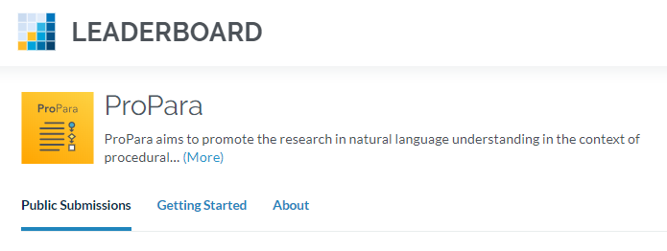
3. Modeling World States
Paragraph
State changes: $π$
water | light | CO2 | sugar
soil | sun | ? | -
roots | sun | ? | -
leaf | sun | ? | -
leaf | leaf | leaf | -
- | - | - | leaf
s1 | Roots absorb water from soil.
s2 | The water flows to the leaf.
s3 | Light and CO2 enter leaf.
s4 | Water, light, CO2 form sugar.
s1
s2
s3
s4

Slide 84


4. Explanation and Instruction
Can you pick up a penny with a magnet?
Yes
Why?
Because
pennies are made of metal
metals are magnetic
Actually:
Not all metals are magnetic.
Copper is not magnetic.
Try again!
No – because:
pennies are made of copper
copper is not magnetic
Notes:
People are not black boxes – we can explain our reasoning, and modify our behavior based on feedback.
We want the same for our machines.
System needs to perform reliable reasoning process with language-like representations.
It needs to explain that reasoning, where the explanation approximates the evidence used
Needs to respond to modified evidence

Slide 85
A Question for the field of Knowledge Capture
Structured
Knowledge
Language
(and other
media)
problem
relevant
information

Slide 86
A Question for the field of Knowledge Capture
Structured
Knowledge
problem
Language
(and other
media)
relevant
information
Notes:
I’ve tried to show that we do need structured reasoning, perhaps more with language than with formal predicate-argument structures, to build more powerful machines.
Do we need structured knowledge? There’s a cost to building them, but a benefit that they are clean of irrelevant information and authoritative. As neural systems are continuously thirsty for data, a healthy supply of structured knowledge can only help!

Slide 87
Summary
Surprising success!
LMs: Structure not essential for many tasks
>> “just pattern matching”
BUT:
falls short with numerous types of questions
many other AI aspects missing
What do we need going forward?
Structured reasoning and knowledge capture but with more language-like representations
Thank you!
Notes:
LMs has shown us that structured K is not essential for many tasks.
But what I’ve tried to show here is that there are limits, and to go beyond those limits we need both structured reasoning and representation.
Do we need structured knowledge repositories? Sure – our systems need knowledge, and cleaner is better than dirty.

